Slide 1


ITM 540
Data Networks
The Network Layer
Layer 3
Dynamic Routing
Professor: Carol Davids
Email: davids@iit.edu
Carol Davids © 2009
Notes:
동적 라우팅 autonomy

Slide 2
Reading Assignment
Forouzan :
Chapter 22: Unicast Routing:
Carol Davids © 2009

Slide 3
Unicast Routing
Unicast communication – one source and one destination
Both source and destination addresses are unicast addresses
When a router receives a packet it forwards the packet through only one of its interfaces
The interface is the one that is associated with the optimal path
Carol Davids © 2009

Slide 4
Metric
Routers choose the path that an IP datagram takes through the network.
The choice is made by optimizing some metric.
The metric can represent different aspects of the path.
Carol Davids © 2009

Slide 5
Examples of Metrics
Number of hops between source and destination
Throughput on the links
Delay on the links
Carol Davids © 2009

Slide 6
Static Routing
There are three ways to statically add routes to a routing table:
  Add manually using route commands
  Add by default when the system is configured by route commands issued at bootstrap time
  Add by ICMP redirect messages
Carol Davids © 2009

Slide 7
Dynamic Routing
Dynamic routing methods for filling the routing table are used if:
  The network is large
  The network is attached to several networks
  There is more than one route between this network and another
Dynamic routing is necessary on the Internet since the links and nodes are subject to frequent and unpredictable changes
Carol Davids © 2009
Notes:
Telling each other ,

Slide 8
Dynamic Routing
Dynamic routing methods enable routers to communicate with each other and to build their routing tables automatically
Carol Davids © 2009

Slide 9
Routing Protocols - Routing Daemons
Routers communicate with each other across the network using routing protocols.
The process that runs the routing protocol inside a particular router is called the routing daemon.
Carol Davids © 2009

Slide 10
Routing Daemon
The routing daemon updates the routing table with information received in routing protocol messages.
Carol Davids © 2009

Slide 11
Router’s Routing Mechanism
  Look in the routing table for a matching host address
  Look in the routing table for a matching network address.
  If no match is found, send the packet to the default address
  If no match and no default address, send an ICMP error message.
Carol Davids © 2009

Slide 12
Routing Policy
The routing daemon implements routing policy
It uses a routing protocol to learn the route between itself and other destinations
Different routing protocols will produce different routes
The routing policy will determine which routes are put into the routing table
Carol Davids © 2009

Slide 13
Autonomous System (AS)
The internet consists of a set of Autonomous Systems each of which is administered independently by a single administrative entity.
Each autonomous system is free to choose the routing policy it will implement within its AS.
Carol Davids © 2009

Slide 14
Intermediate System - IS
An intermediate system is a node on a network that provides routing services.
Carol Davids © 2009

Slide 15
End System - ES
An end system is a node on a network that does not provide routing services.
Carol Davids © 2009

Slide 16
Interior Gateway Protocol
The protocol that is used by the Autonomous System (AS) to implement routing on the AS is called its Interior Gateway Protocol.
Most commonly used IGPs are:
  RIP - Routing Information Protocol
  OSPF - Open, Shortest Path First
Carol Davids © 2009

Slide 17
Exterior Gateway Protocol - EGP
The protocol that is used between routers on different Autonomous System (AS) to implement routing between them.
Most commonly used EGPs are:
  EGP – Exterior Gateway Protocol
  BGP – Border Gateway Protocol
Carol Davids © 2009
Notes:
Route outside 에

Slide 18
Scope of this course
We will study two Interior routing protocol – RIP and OSPF.
We will study one Exterior routing protocol – BGP.
Carol Davids © 2009

Slide 19
Exterior and interior routing protocols can run on the same router
When a router on one autonomous system must communicate with routers on other autonomous systems, the router must run both an Exterior and an Interior routing protocol.
Carol Davids © 2009

Slide 20
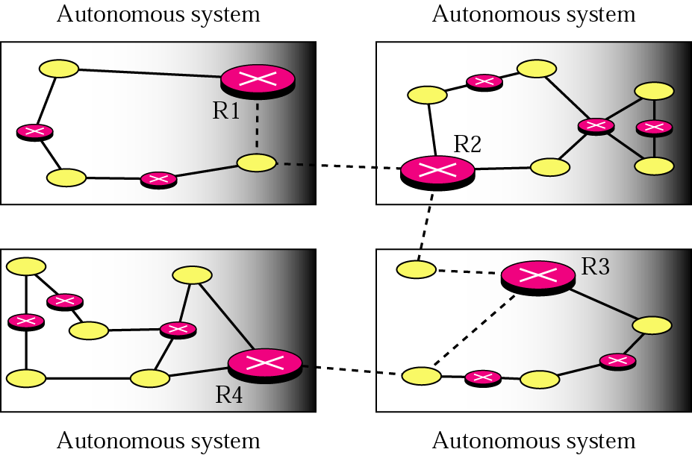
Exterior and interior routing protocols
R1, R2, R3, and R4 are all running both interior and exterior routing protocols. (dotted lines indicate exterior - solid lines indicate interior.)
Carol Davids © 2009

Slide 21
RIP : Routing Information Protocol
RIP is an Interior routing protocol.
RIP is specified in RFC 1058, written in 1988, 33 pages long
RIP II is specified in RFC 1388, written in 1993, 6 pages long
Carol Davids © 2009

Slide 22
RIP Metric
In general, the metric of a routing protocol represents the cost of taking a particular route
For RIP, the cost is a hop count.
A hop count is the number of hops that are needed to get from the source to the destination.
Carol Davids © 2009

Slide 23
RIP – A Distance Vector Protocol
The hop count represents a measure of the distance between the source and the destination
Carol Davids © 2009

Slide 24
RIP – A Distance Vector Protocol
Each router creates a one-dimensional array or vector whose elements contain the distance in hops between the router and all the other routers on the AS
For this reason RIP is called a Distance Vector protocol.
Carol Davids © 2009

Slide 25
Distance Vector
Distance vector is a one-dimensional array of numbers.
Each number represents the number of hops between the router in question and another router on the AS.
c1
c2
c3
c4
c5
c6
c8
c9
Carol Davids © 2009

Slide 26
RIP Message
The RIP message is a list that associates:
  Destination IP addresses with
  Hop counts to each of those destination addresses.
Carol Davids © 2009

Slide 27
Routing Table
The routing table contains one entry for each destination network the router knows about
The routing table will include these 3 columns:
  Destination IP address
  Hop Count
  Next Router
Carol Davids © 2009

Slide 28
RIP Message
The RIP message will contain 2 columns:
  Destination IP address
  Hop Count
Carol Davids © 2009

Slide 29
RIP Message
The RIP message does not contain the next hop.
Why?
Because, from the point of view of the receiver of the RIP message, the source of the RIP message would be its next hop.
That is, if you tell me it would take 3 hops to get from your network to network A, then I know that I am 1 hop away from you so it should take me 4 hops to get to network A if I take the path through your network.
Carol Davids © 2009

Slide 30
Key to the RIP Updating Method
When a router receives a RIP message
It adds one hop to the hop count of each destination advertised in the message
Why? Because the information is true at the sender’s location not at the current location. It cost a hop for this message to get to to its current location, so the routing process needs to add a hop to the hop count to make this information valid at the current location.
Carol Davids © 2009

Slide 31
RIP Updating Method
For each destination advertised in the RIP message, do the following set of steps:
Carol Davids © 2009

Slide 32
RIP Updating Method
  1. Add 1 to the advertised hop count
  2. If destination is not in routing table, add this information to your routing table
Carol Davids © 2009

Slide 33
RIP Updating Method continued
  3. If destination is in your routing table, check if the next-hop field in the routing table is equal to the source of this RIP message
  4. If it is, then replace the cost in your routing table with the information you just received in the RIP message.
  Why? Because the router that is your next hop has just told you that he can’t get there at that price any more. Believe him!
Carol Davids © 2009

Slide 34
RIP Updating Method continued
  5. If the next hop field in your routing table is not the same as the source address from which this message came, then …
  6. Compare the value in the updated RIP message’s hop count with the hop count in the routing table.
Carol Davids © 2009

Slide 35
RIP Updating Method continued
  7. If the updated hop count is less than the value in your routing table, replace the entry in your routing table.
Carol Davids © 2009

Slide 36
RIP Updating Method
  8. If the updated hop count is greater than or equal to that in the routing table, do not change the routing table.
Carol Davids © 2009

Slide 37
Initializing the Routing Table
When a router is added to the network it initializes its routing table using its configuration file.
Carol Davids © 2009

Slide 38
Initializing the Routing Table
The initial routing table contains a list of directly attached networks with hop counts initialized to 1.
As the routers receive RIP messages they update their routing tables.
Carol Davids © 2009

Slide 39
RIP Updating Method Example 1
In the example on the following pages, Router R receives a RIP message from Router C.
Carol Davids © 2009

Slide 40
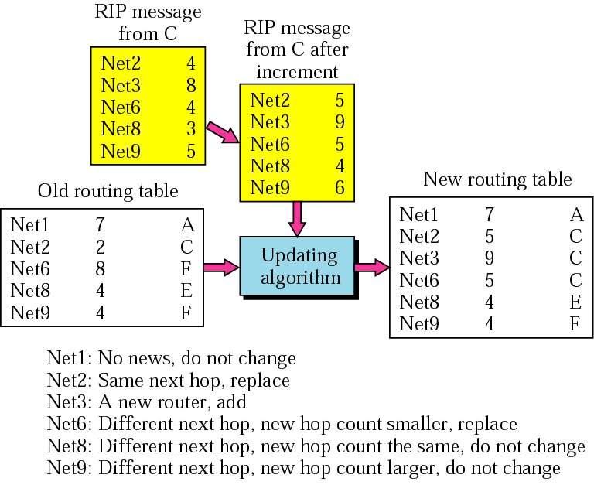
RIP Updating Method Example 1
Router R receives a RIP message from Router C.
Carol Davids © 2009

Slide 41
RIP Updating Method Example 1
A RIP message comes to R from C.
R updates the incoming RIP message by adding 1 to each of the hop counts that C advertises.
Then R compares lines in its current routing table with the new information that C has sent it.
R makes changes to its current (old) routing table as follows:
Carol Davids © 2009

Slide 42
RIP Updating Method Example 1
The advertisement from C did not mention a route to Net 1, so the current entry in R’s routing table for Net 1 does not change.
Carol Davids © 2009

Slide 43
RIP Updating Method Example 1
The advertisement from C describes a route to Net 2. This route costs C, 4 hops and so will cost R 5 hops. (One hop to get to C, and 4 hops to get from C to Net 1.)
Carol Davids © 2009

Slide 44
RIP Updating Method Example 1
We need to update the routing table to reflect this value of 5 hops because our old route went through C and this RIP message says something has changed on that route.
On the next page, I illustrate my method for working these problems. I create a “pseudo-entry” into the routing table, indicating what the table would look like if I did adopt all the routes provided. Note that all the “next hops” are C.
Carol Davids © 2009

Slide 45
RIP message from
C
RIP message with
Net 2 4
hop counts
Net 3 8
incremented by 1
RIP message
Net 6 4
Net 8 3
You can add a column
that reminds you whence
this information
Net 9 5
add 1 to hop count
Net 2 5
C
C
C
C
C
Net 3 9
Net 6 5
Net 8 4
Net 9 6
Old Routing Table
New Routing Table
Net 1 7 A
Net 1 7 A
Net 2 2 C
Net 2 5 C
Net 6 8 F
Updating
Net 3 9 C
Net 8 4 E
Algorithm
Net 6 5 C
Net 9 4 F
Net 8 4 E
Net 9 4 F
Carol Davids © 2009

Slide 46
RIP Updating Method Example 2
In this example, examine Router A’s initial routing table and compare it to Router A’s final routing table.
Carol Davids © 2009

Slide 47
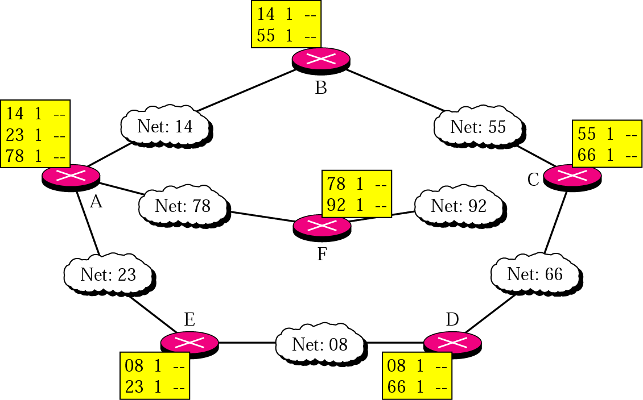
RIP Updating Method Example 2
Router A’s initial routing table
Carol Davids © 2009

Slide 48
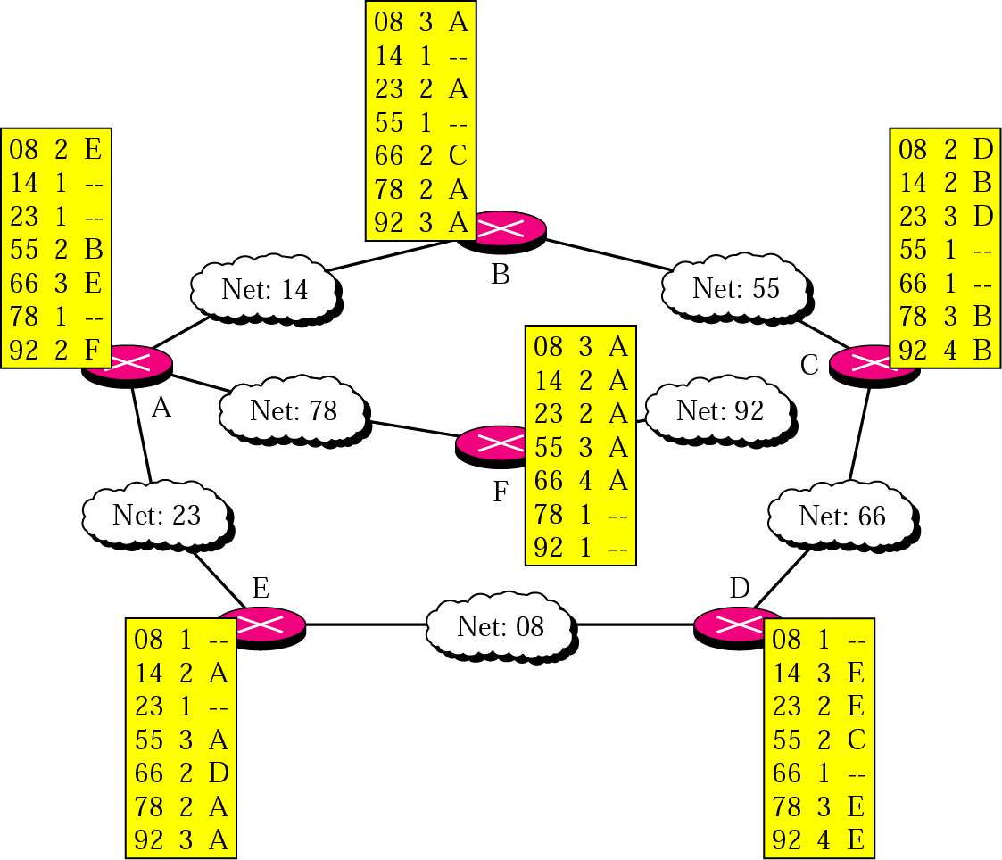
RIP Updating Method Example 2
Router A’s final routing table
Carol Davids © 2009

Slide 49
Router A - initially
In its configuration file, router A learns that it is connected to Net 14, Net 78 and Net 23
It assigns a cost of 1 hop to each of its directly connected networks
Carol Davids © 2009

Slide 50
Router A – in process
Now router A receives a RIP message from Router B
The message indicates that B is directly connected to Net 55 at a cost of 1
So A adds Net 55 to its routing table and assigns it a cost of 2(1 hop to get to B and then 1 hop to get from to Net 55.)
See notes on “split horizon” at the end of these slides, under RFC 2453.
Carol Davids © 2009

Slide 51
Router A – finally
After Router A has received and processed all the initial RIP messages it has a view of the network seen in final network view pg 44.
It costs 2 hops to get to Net 08 from A via E.
It costs 2 hops to get to Net 55 from A via B.
And so on
We can see this visually, but Router A cannot
So Router A applied the RIP method to deduce this information.
Carol Davids © 2009

Slide 52
Network Graph is human’s routing table
Humans construct graphs whose nodes and edges represent the network
The Router’s routing table is the router’s representation of the human-friendly graphs
Carol Davids © 2009

Slide 53
Routing Algorithms
Routing is a problem of graph theory.
  We use a graph to represent a network.
  The graph consists of nodes and edges.
  The nodes represent routers.
  The edges represent network links.
  We associate a cost with each edge.
Carol Davids © 2009

Slide 54
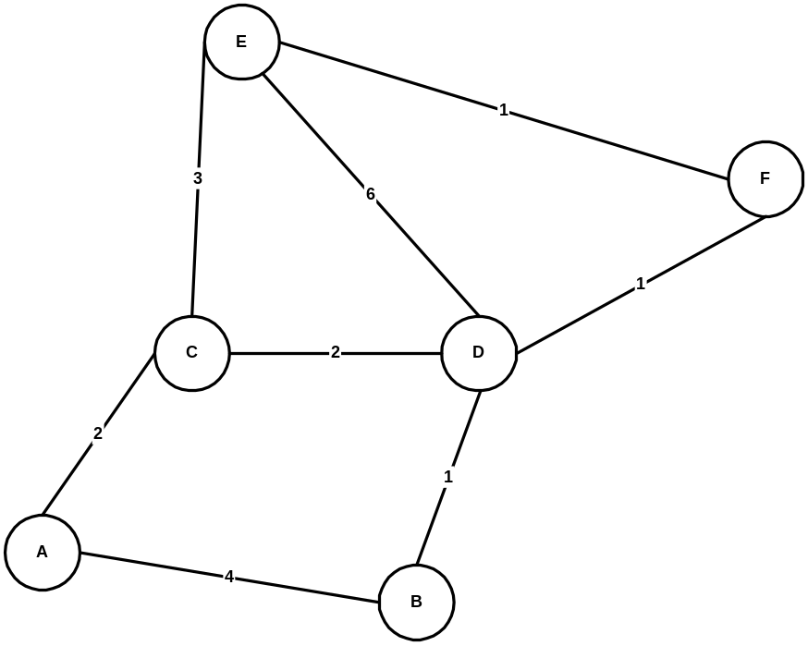
Network Graph
Nodes - A,B,C.. represent routers
Edges represent links
Numbers on edges represent cost of using the link
Carol Davids © 2009

Slide 55
Initializing the routing table
The example on the following pages shows how a router uses its provisioned information about its neighbors and RIP messages received from routers on its AS to create its routing table.
Carol Davids © 2009

Slide 56
Distance Vector Algorithm for choosing routes
  Each node constructs an array - also called a vector - containing the costs of each link to a node.
  Each node distributes this vector to all its immediate neighbors.
Carol Davids © 2009

Slide 57
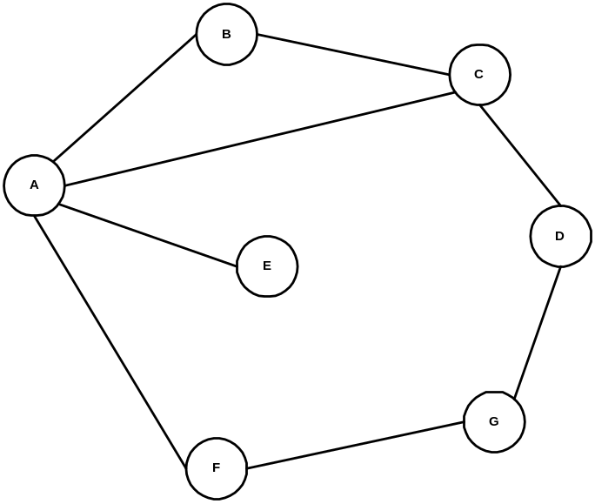
Illustration of Distance Vector Routing
This example is adapted from Peterson and Davie, Computer Networks, A Systems Approach.
Carol Davids © 2009

Slide 58

  Begin by assigning a value of 1 to every directly-connected link.
  At Node A the distance vector looks like this.
In the tables, the letter X represents Infinity.
Carol Davids © 2009
Notes:
you are router x

Slide 59
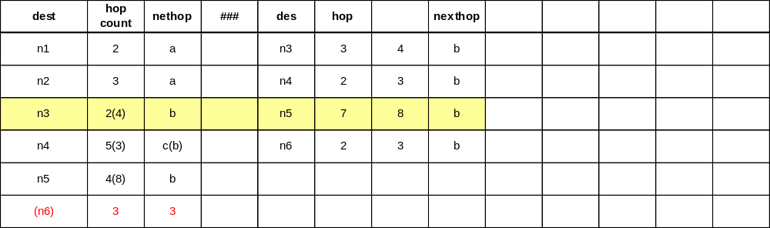
  Your router
In the tables, the letter X represents Infinity.
Carol Davids © 2009
Notes:
you are router x

Slide 60
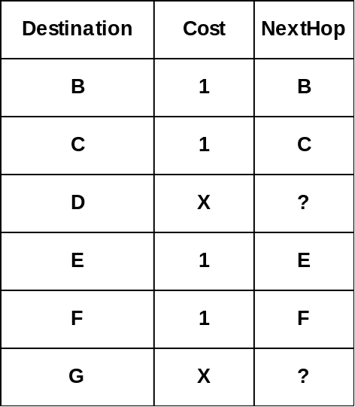
The routing table at Node A reflects this information as follows:
X means infinity in the Cost column and none in the NextHop column.
Carol Davids © 2009

Slide 61
  At Node B the distance vector looks like this.
Carol Davids © 2009

Slide 62
  At Node C the distance vector looks like this.
Carol Davids © 2009

Slide 63
  At Node D the distance vector looks like this.
Carol Davids © 2009

Slide 64
  At Node E the distance vector looks like this.
Carol Davids © 2009

Slide 65
  At Node F the distance vector looks like this.
Carol Davids © 2009

Slide 66
  At Node G the distance vector looks like this.
Carol Davids © 2009

Slide 67
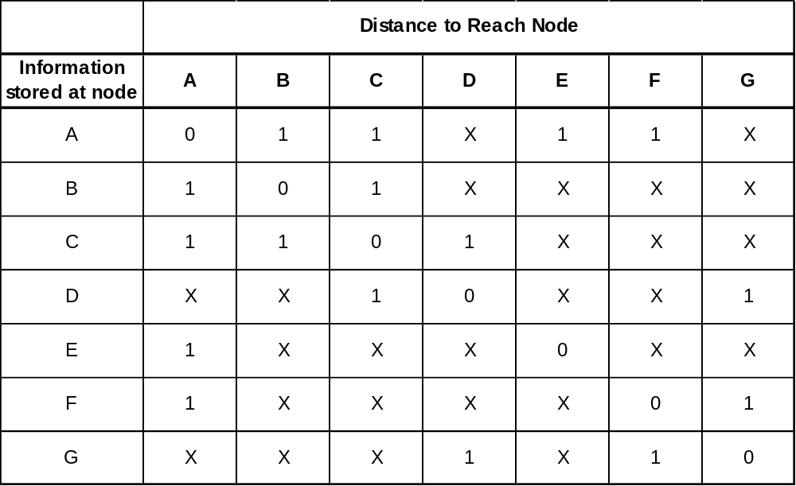
  All the information on the last pages can be collected into a table that looks like this:
Carol Davids © 2009

Slide 68
  BUT, this table does not exist anywhere on the network!
  There is no centralized database with routing information.
  Routing is a distributed function.
Carol Davids © 2009

Slide 69
  Processes running on each router co-operate to enable internet-wide routing.
  But there is no centralized authority in charge of it.
Carol Davids © 2009

Slide 70
Now, every node in the network sends a message containing its own distance vector to every directly connected neighbor.
Below, A receives F’s distance vector. It contains information about a route to G. So A updates it’s routing table as shown.
Carol Davids © 2009

Slide 71
When F sends its distance vector to A, here is what happens:
  A knows it can reach F at a cost of 1.
  A knows that F can reach G with a cost of 1.
  So now A knows it can reach G with a cost of 2.
  The old cost of going to G from A was infinity.
  2 is less than infinity, so A updates its distance vector
Carol Davids © 2009

Slide 72
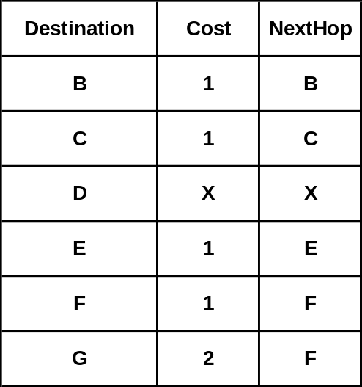
A also updates its routing table with the new cost and next hop as follows:
Carol Davids © 2009

Slide 73
When C sends its distance vector to A, here is what happens:
Carol Davids © 2009

Slide 74
  A knows it can reach C at a cost of 1.
  A knows that C can reach D with a cost of 1.
  So now A knows it can reach D with a cost of 2.
Carol Davids © 2009

Slide 75
  The old cost of going to D from A was infinity.
  2 is less than infinity, so A updates its distance vector
Carol Davids © 2009

Slide 76
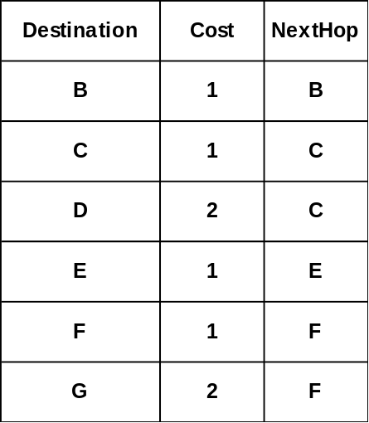
A again updates its routing table with the new cost and next hop as follows:
Carol Davids © 2009

Slide 77
Convergence
The process whereby all the nodes get complete routing tables is called Convergence.
It takes a finite amount of time to reach convergence.
One goal of routing is to reach convergence quickly.
Carol Davids © 2009

Slide 78
Pros and Cons of distributed routing function
The fact that the routing function is distributed has a good side and a bad side.
The good side is that the routing is scalable.
The bad side is that it is hard to keep the routing tables synchronized.
Carol Davids © 2009

Slide 79
  Successful synchronization of Routes
For example, if the link between F and G fails, F will send out a new distance vector with the distance from F to G set to infinity.
Carol Davids © 2009

Slide 80
  Successful synchronization of Routes
A creates a new distance vector based on this new information, and so sets the cost of the route from A to G to infinity.
Carol Davids © 2009

Slide 81
  Successful synchronization of Routes
Now C sends a distance vector to A, telling A it has a 2 hop route to G.
Thus A learns that it has a 3 hop path to G through C.
Carol Davids © 2009

Slide 82
  Unsuccessful synchronization of Routes
Suppose the link from A to E goes down. A will advertise the distance from A to E is infinity.
Carol Davids © 2009

Slide 83
  Unsuccessful synchronization of Routes
B and C still advertise the distance to E as 2.
B to E via A and C to E via A.
Carol Davids © 2009

Slide 84
  Unsuccessful synchronization of Routes
If B hears that that it can’t get to E via A, it may still think it can get to E in 3 hops via C.
B tells A about this route so now A thinks it can get to E in 4 hops via B.
Carol Davids © 2009

Slide 85
  Unsuccessful synchronization of Routes
B tells C about this route so now C thinks it can get to E in 5 hops via B, and so on ….
Carol Davids © 2009

Slide 86
  Unsuccessful synchronization of Routes
This spiral only ends when some maximum number of hops is reached.
Some networks define a relatively small number of hops as ‘infinity’ to prevent this type of instability from going on too long.
Carol Davids © 2009

Slide 87
RIP Protocol Messages
RIP and RIP II are Distance Vector routing protocols.
RIP protocol messages contain distance vectors.
Carol Davids © 2009

Slide 88
Encapsulation of RIP protocol messages
RIP protocol messages are encapsulated in UDP datagrams.
UDP Port 520 is used as the input/output port for the RIP process.
Carol Davids © 2009

Slide 89
UDP Encapsulation of RIP messages
UDP is a Transport Layer protocol that is encapsulated in IP datagrams.
It has a very short header - only 8 bytes.
UDP provides a best-effort transport service.
Carol Davids © 2009

Slide 90
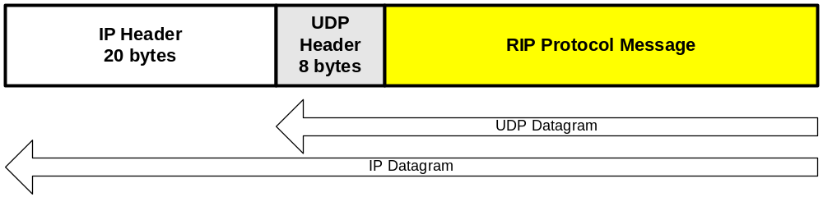
UDP Encapsulation of RIP messages
The drawing shows a RIP protocol message encapsulated in a UDP datagram, which is in turn encapsulated in an IP datagram.
Carol Davids © 2009

Slide 91
RIP Protocol Message Format
The fields of the RIP protocol message are:
  An 8 bit command field (1 byte)
  An 8 bit version field (1 byte)
  A 16 bit field always set to 0
  A 16 bit address family field (2 bytes)
  A set of fields that represent 1 or more Routes.
  (Up to 25 Routes can be included in one message.)
Carol Davids © 2009

Slide 92
Route
A Route includes
  An Address Family = 16 bits (2 byte)
  An IP Address = 32 bits (4 bytes)
  A Metric field = 32 bits (4 bytes)
There are additional fields that are all 0’s in RIP and have variable values in RIP II.
A Route is a total of 20 bytes long.
Carol Davids © 2009

Slide 93
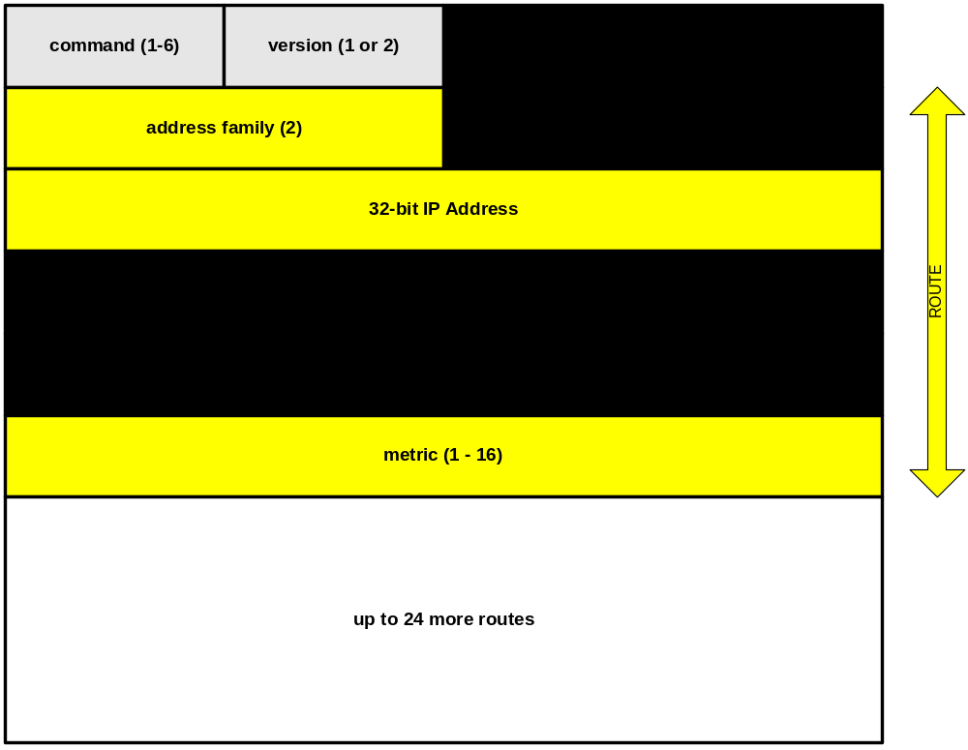
Carol Davids © 2009

Slide 94
Command Field
The command field tells the purpose of the message
The values in the command field can range from 1 to 6
Carol Davids © 2009

Slide 95
Command Field
1 - Request
A request for the responding system to send all or part of its routing table.
2 - Response
A message containing all or part of the sender's routing table.
This message may be sent in response to a request or poll, or it may be an update message generated by the sender.
Carol Davids © 2009

Slide 96
Other fields
For requests and responses, the rest of the datagram contains a list of destinations, with information about each.
Each entry in this list contains a destination network or host, and the metric for it.
Carol Davids © 2009

Slide 97
Address Family
This packet format allows RIP to carry routing information for several different network protocols.
The address family identifier tells what type of network address is specified in that entry.
The address family identifier for IP is 2.
Carol Davids © 2009

Slide 98
IP Address
The IP address is the usual Internet address, stored as 4 octets in network order.
It represents the destination address whose route we are considering.
Carol Davids © 2009

Slide 99
Metric
The metric field must contain a value between 1 and 15 inclusive
This metric specifies the current metric for the destination
The value 16 indicates that the destination is not reachable. (infinity)
Each route sent by a gateway supercedes any previous route to the same destination from the same gateway.
Carol Davids © 2009

Slide 100
Example from ripv1 trace
Routing Information Protocol
Command: Response (2)
Version: RIPv1 (1)
IP Address: 7.0.0.0, Metric: 4
Address Family: IP (2)
IP Address: 7.0.0.0 (7.0.0.0)
Metric: 4
IP Address: 8.0.0.0, Metric: 3
Address Family: IP (2)
IP Address: 8.0.0.0 (8.0.0.0)
Metric: 3
IP Address: 9.0.0.0, Metric: 3
Address Family: IP (2)
IP Address: 9.0.0.0 (9.0.0.0)
Metric: 3
Carol Davids © 2009

Slide 101
Example from ripv1 trace (continued)
IP Address: 10.0.0.0, Metric: 2
Address Family: IP (2)
IP Address: 10.0.0.0 (10.0.0.0)
Metric: 2
IP Address: 11.0.0.0, Metric: 2
Address Family: IP (2)
IP Address: 11.0.0.0 (11.0.0.0)
Metric: 2
IP Address: 12.0.0.0, Metric: 1
Address Family: IP (2)
IP Address: 12.0.0.0 (12.0.0.0)
Metric: 1
IP Address: 13.0.0.0, Metric: 1
Address Family: IP (2)
IP Address: 13.0.0.0 (13.0.0.0)
Metric: 1
Carol Davids © 2009

Slide 102
Split horizon
Information from RFC 2453 RIP II
3.4.3 Split horizon
Note that some of the problem above is caused by the fact that A and C are engaged in a pattern of mutual deception. Each claims to be able to get to D via the other. This can be prevented by being a bit more careful about where information is sent.
In particular, it is never useful to claim reachability for a destination network to the neighbor(s) from which the route was learned. "Split horizon" is a scheme for avoiding problems caused by including routes in updates sent to the router from which they were learned.
Carol Davids © 2009

Slide 103
Split horizon with poison reverse
Information from RFC 2453 RIP II
3.4.3 Split horizon
The "simple split horizon" scheme omits routes learned from one neighbor in updates sent to that neighbor. "Split horizon with poisoned reverse" includes such routes in updates, but sets their metrics to infinity.
Carol Davids © 2009

Slide 104
Additional information from web sources
This appendix contains some information relative to routers and routing that may be interesting. It is intended as illustrative material
Carol Davids © 2009

Slide 105
From : Cisco* Documentation for configuring RIP
Adjusting Timers
Routing protocols use several timers that determine such variables as the frequency of routing updates, the length of time before a route becomes invalid, and other parameters.
You can adjust these timers to tune routing protocol performance to better suit your internetwork needs. You can make the following timer adjustments:
*http://www.cisco.com/univercd/cc/td/doc/product/software/ios122/122cgcr/fipr_c/ipcprt2/1cfrip.htm#wp1002500
Carol Davids © 2009

Slide 106
From : Cisco* Documentation for configuring RIP
• The rate (time in seconds between updates) at which routing updates are sent
• The interval of time (in seconds) after which a route is declared invalid
• The interval (in seconds) during which routing information regarding better paths is suppressed
• The amount of time (in seconds) that must pass before a route is removed from the routing table
• The amount of time for which routing updates will be postponed
*http://www.cisco.com/univercd/cc/td/doc/product/software/ios122/122cgcr/fipr_c/ipcprt2/1cfrip.htm#wp1002500
Carol Davids © 2009

Slide 107
From : Cisco* Documentation for configuring RIP
• It also is possible to tune the IP routing support in the software to enable faster convergence of the various IP routing algorithms, and, hence, quicker fallback to redundant routers.
The total effect is to minimize disruptions to end users of the network in situations where quick recovery is essential.
*http://www.cisco.com/univercd/cc/td/doc/product/software/ios122/122cgcr/fipr_c/ipcprt2/1cfrip.htm#wp1002500
Carol Davids © 2009

Slide 108
From : Cisco* Documentation for configuring RIP
• In addition, an address family can have explicitly specified timers that apply to that address-family (or VRF) only.
The timers basic command must be specified for an address family or the system defaults for the timers basic command are used regardless of what is configured for RIP routing.
*http://www.cisco.com/univercd/cc/td/doc/product/software/ios122/122cgcr/fipr_c/ipcprt2/1cfrip.htm#wp1002500
Carol Davids © 2009

Slide 109
From : Cisco* Documentation for configuring RIP
The VRF does not inherit the timer values from the base RIP configuration.
The VRF will always use the system default timers unless explicitly changed using the timers basic command.
*http://www.cisco.com/univercd/cc/td/doc/product/software/ios122/122cgcr/fipr_c/ipcprt2/1cfrip.htm#wp1002500
Carol Davids © 2009

Slide 110
From : Cisco* Documentation for configuring RIP
Router(config-router)# timers basic update invalid holddown flush [sleeptime]
http://www.cisco.com/univercd/cc/td/doc/product/software/ios122/122cgcr/fipr_c/ipcprt2/1cfrip.htm#wp1002500
Carol Davids © 2009

Slide 111
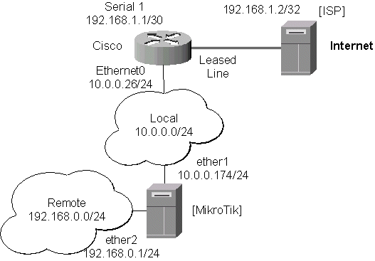
From : MikroTIK*
*http://www.mikrotik.com/Documentation/manual_2.6/Routing/RIP.html
Carol Davids © 2009

Slide 112
From : MikroTIK*
The configuration of the MikroTik router is as follows:
[admin@MikroTik] > interface print
Flags: X - disabled, D - dynamic, R - running
# NAME TYPE MTU
0 R ether1 ether 1500
1 R ether2 ether 1500
*http://www.mikrotik.com/Documentation/manual_2.6/Routing/RIP.html
Carol Davids © 2009

Slide 113
From : MikroTIK*
[admin@MikroTik] > ip address print
Flags: X - disabled, I - invalid, D - dynamic
# ADDRESS NETWORK BROADCAST INTERFACE
0 10.0.0.174/24 10.0.0.174 10.0.0.255 ether1
1 192.168.0.1/24 192.168.0.0 192.168.0.255 ether2
*http://www.mikrotik.com/Documentation/manual_2.6/Routing/RIP.html
Carol Davids © 2009

Slide 114
From : MikroTIK*
[admin@MikroTik] > ip route print
Flags: X - disabled, I - invalid, D - dynamic, J - rejected, C - connect, S - static, R - rip, O - ospf, B - bgp
# DST-ADDRESS G GATEWAY DISTANCE INTERFACE
0 DC 192.168.0.0/24 r 0.0.0.0 0 ether2
1 DC 10.0.0.0/24 r 0.0.0.0 0 ether1
*http://www.mikrotik.com/Documentation/manual_2.6/Routing/RIP.html
Carol Davids © 2009

Slide 115
From : MikroTIK*
The regular routing table is:
[MikroTik] routing rip> /ip route print
Flags: X - disabled, I - invalid, D - dynamic, J - rejected, C - connect, S - static, R - rip, O - ospf, B - bgp
# DST-ADDRESS G GATEWAY DISTANCE INTERFACE
0 R 0.0.0.0/0 r 10.0.0.26 120 ether1
1 R 192.168.3.0/24 r 10.0.0.26 120 ether1
2 R 192.168.1.0/24 r 10.0.0.26 120 ether1
3 DC 192.168.0.0/24 r 0.0.0.0 0 ether2
4 DC 10.0.0.0/24 r 0.0.0.0 0 ether1
[admin@MikroTik] routing rip>
*http://www.mikrotik.com/Documentation/manual_2.6/Routing/RIP.html
Carol Davids © 2009

Slide 116
From : MikroTIK*
Cisco#show ip route
Codes:
C - connected, S - static, I - IGRP, R - RIP, M - mobile, B - BGP
D - EIGRP, EX - EIGRP external, O - OSPF, IA - OSPF inter area
N1 - OSPF NSSA external type 1, N2 - OSPF NSSA external type 2
E1 - OSPF external type 1, E2 - OSPF external type 2, E - EGP
i - IS-IS, L1 - IS-IS level-1, L2 - IS-IS level-2, * - candidate default
U - per-user static route, o - ODR
*http://www.mikrotik.com/Documentation/manual_2.6/Routing/RIP.html
Carol Davids © 2009

Slide 117
From : MikroTIK*
Gateway of last resort is 192.168.1.2 to network 0.0.0.0
10.0.0.0/24 is subnetted, 1 subnets
C 10.0.0.0 is directly connected, Ethernet0
R 192.168.0.0/24 [120/1] via 10.0.0.174, 00:00:19, Ethernet0 192.168.1.0/30 is subnetted, 1 subnets
C 192.168.1.0 is directly connected, Serial1
R 192.168.3.0/24 [120/1] via 192.168.1.2, 00:00:05, Serial1
R* 0.0.0.0/0 [120/1] via 192.168.1.2, 00:00:05, Serial1
Cisco#
As we can see, the Cisco router has learned RIP routes both from the MikroTik router (192.168.0.0/24), and from the ISP router (0.0.0.0/0 and 192.168.3.0/24).
*http://www.mikrotik.com/Documentation/manual_2.6/Routing/RIP.html
Carol Davids © 2009

Slide 118
From : MikroTIK*
*http://www.mikrotik.com/Documentation/manual_2.6/Routing/RIP.html
Carol Davids © 2009

